Slide 1
PCIM Purpose
December 2022
Eldon Metz

Slide 2
PCIM – Purpose Goals
Accuracy - Accurate patient and location information stamped on device data increases safety and care efficiency
Patient safety is paramount, transactions and workflow must ensure actors must always have accurate state even after network outage, system downtime, medical device power cycle, etc.
Non-intrusive - Clinical workflow is not burdensome
Clinicians don’t want or have time to search, select patients on all device displays!
Many device vendors don’t provide UI implementations for selecting patients
Non-intrusive workflow is very important for staff. They will not appreciate needing to reassociate confirmed device-patient associations in one or more rooms if a system, device or network goes down.
Simplified setup and low-maintenance configuration
Near zero-touch configuration for reporters, managers, and consumers
Interoperable interfaces facilitate plug and play actor participation

Slide 3
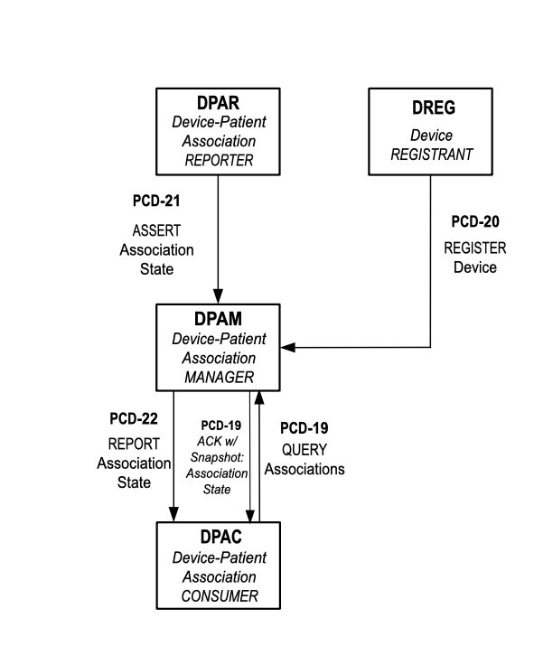
PCIM Actors

Slide 4
Examples of Actors
PCIM Consumer
Medical device (Ventilator, Infusion Pump, Patient Monitor, Dialysis Machine, …)
Clinical applications that needs association information
PCIM Reporter
EMR
Custom software application (desktop, tablet, phone)
Dedicated hardware device in the room
RTLS system with no user interface
Medical device itself in some instances
PCIM Manager
EMR
Cloud-based or on-prem system
Dedicated third-party product or integrated vendor offering

Slide 5
PCIM Transactions
Register Device
Assert Association State
Report Association State
Query Associations

Slide 6
Purpose - Register Device Transaction
Simplifies configuration
Reduces maintenance burden on IT
Accurate roster of devices available for association updated in near real-time

Slide 7
Purpose – Assert Association State
Notifies a manager of an association / disassociation with all necessary info
Device
Patient
Timestamps
Responsible Observers or automated system identifier
Manager performs final approval, conflict resolution
Can be EMR, RTLS, special app..

Slide 8
Purpose – Report Association State
Report an association / disassociation with all necessary info to interested consumers
Device
Patient
Timestamps
Responsible Observers or automated system identifier
Can be EMR, RTLS, special app..

Slide 9
Purpose – Query Associations
Device or application/system gets accurate snapshot of device patient association status at any time. Need to start from accurate baseline before listening in real-time.
Device or application can also subscribe for real-time updates while network connection stays healthy. If network goes down, snapshot gets consumer immediately back to accurate status while resuming real-time feed.
Together, snapshot and real-time modalities always ensure that consumer is guaranteed most accurate up-to-date association status with no additional user intervention
Query message allows simple and complex devices to receive the association data status filtered for devices or patients important to them with no additional IT or clinical engineering interaction. E.g. Pump gateways that can have many pump instances swapped in and out.
Can be medical device, application, etc.

Slide 10
Notes
No one vendor will typically implement all three roles in deployed scenario
Interoperable, hospital system chooses manager and reporters of their choice based on features, IT capabilities and budget

Slide 11
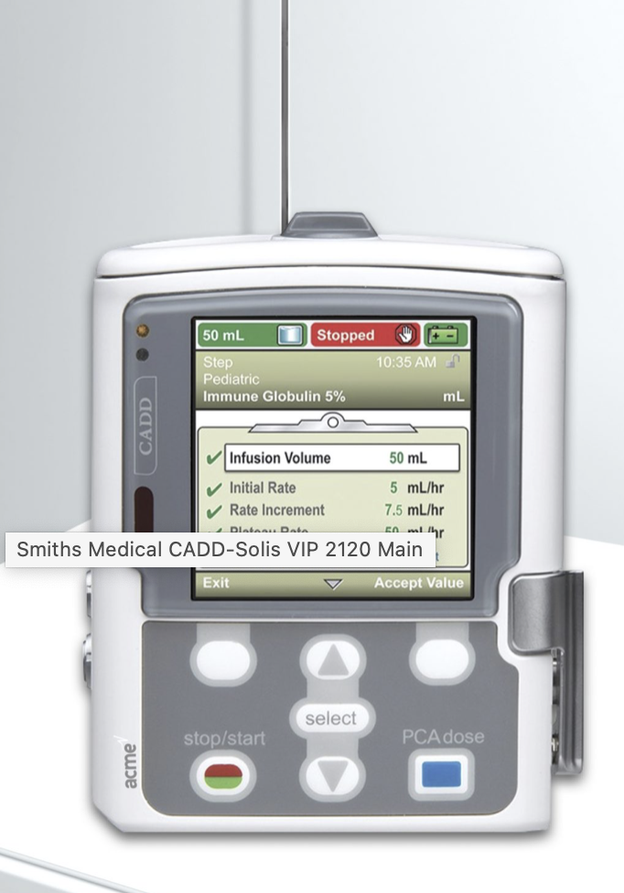
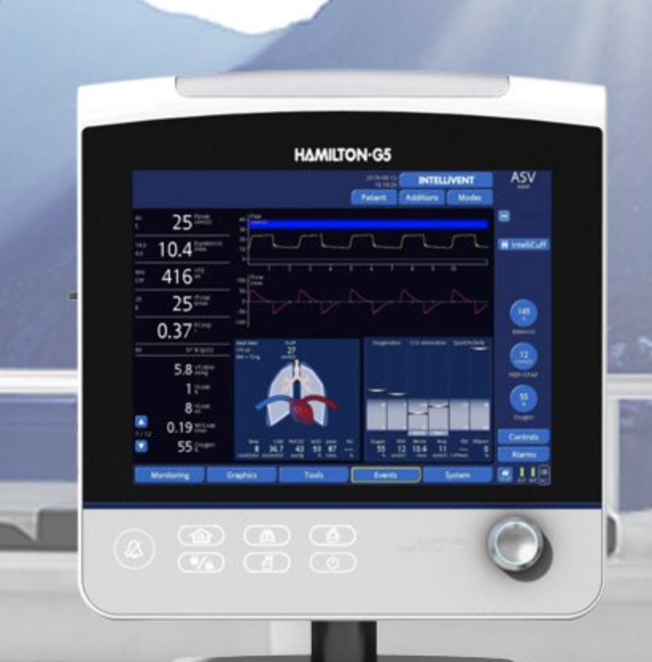
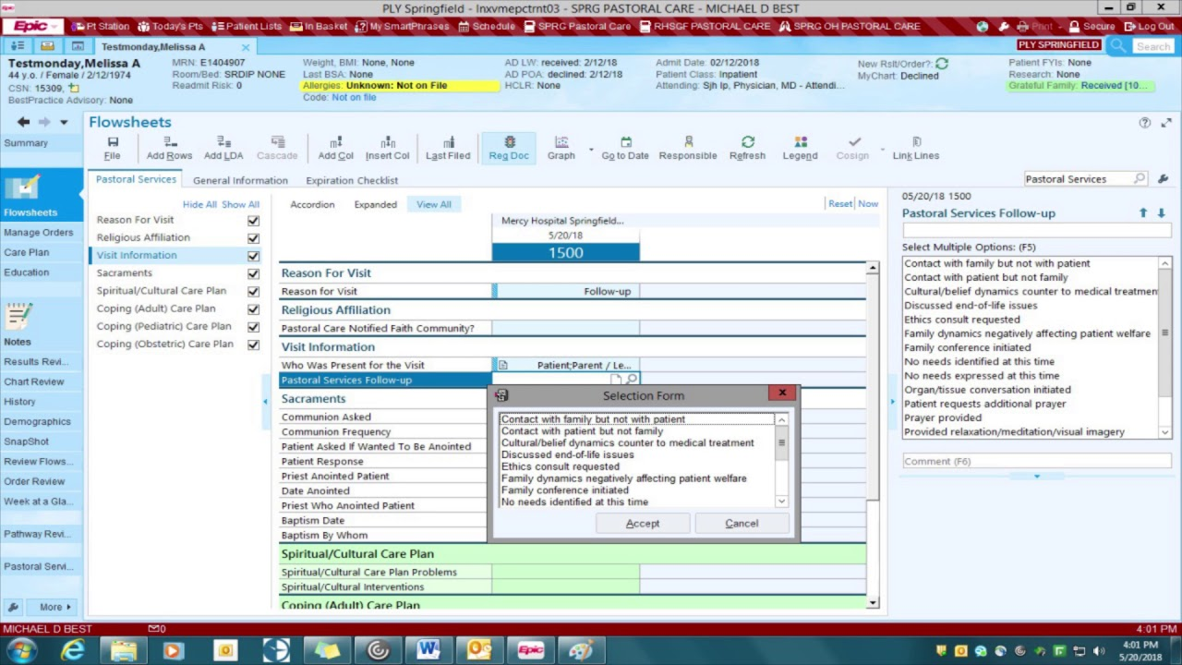

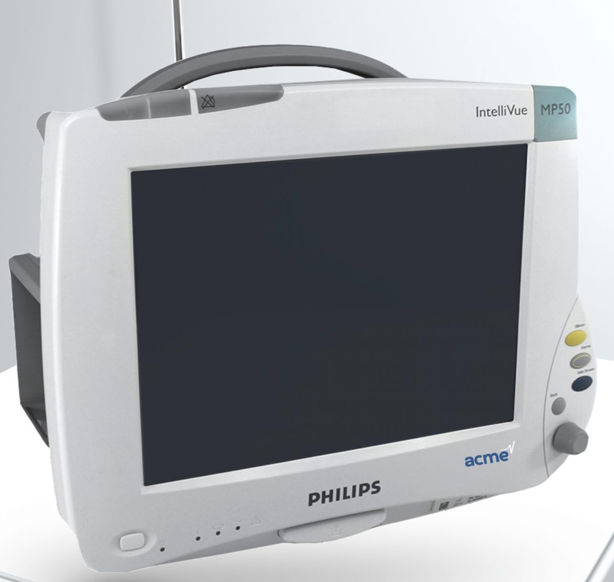
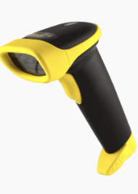
EMR scanner
Pump
Vent
EMR with Scanner
Bed
Monitor
PCIM Manager / Reporter
PCIM Consumers

Slide 12
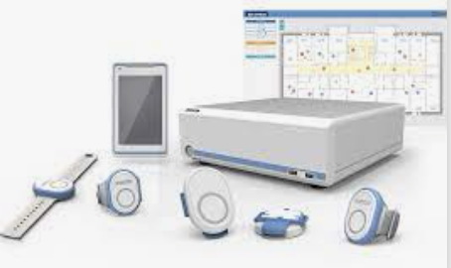
EMR scanner with RTLS
Pump
Vent
EMR with Scanner
Bed
PCIM Manager / Reporter / Consumer
Monitor
RTLS system
PCIM Consumers
PCIM Reporter

Slide 13

PCIM Specification - Roadmap
4Q 2022
1Q 2023
Foundational CP Drafted
2-4Q 2023
Additional CP Review
Update Connectathon Tests
Update NIST HL7v2 Validation
Foundational CP Approval
Foundational CP Review
Additional CP Drafts
Additional CP Review

Slide 14
Existing PCIM Use Cases
Association
Disassociation
Query for devices for a patient
Query for patient associated with a device
Device registration
Query for list of devices for an association (ran out of steam)

Slide 15
Additional PCIM Use Cases
Invalid association and error handling (DPAR <> DPAM)
E.g. Device is not known
E.g. Patient is not known
E.g. Device or patient associated already (association report)
E.g. Device or patient not associated (disassociation report)
Association conflict resolution (DPAR <> DPAM)
E.g. accurate association report, but disassociation latency due to HMI with barcode scanner
Association conflict resolution (DPAC <> DPAM)
E.g. Medical device or gateway detects impossible situation (expand)

Slide 16
PCIM Specification - Next Steps
Foundational CP for transaction changes(PCD-17,18 and PCD 21,22)
PCD 21 for asserting association and disassociation events
PCD 22 for reporting association and disassociation events
PCD 19 clarifications, especially around real-time subscription and connection management approach
Draft CP #1, 2 and 3 would be replaced by this overarching CP
Draft CP for error responses also included as they relate to PCD 21 and PCD 22
Approval of foundational CP
Optional Order ID and other CPs
Update Connectathon Tests and NIST validation tool

Slide 17
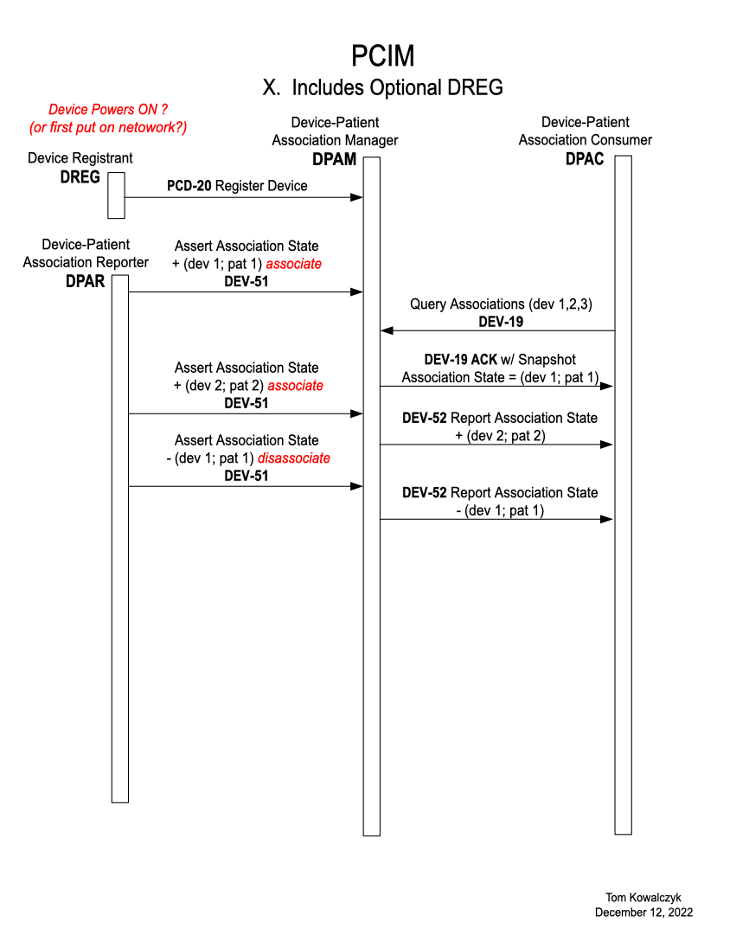
Basic Association Sequence Diagram

Slide 18
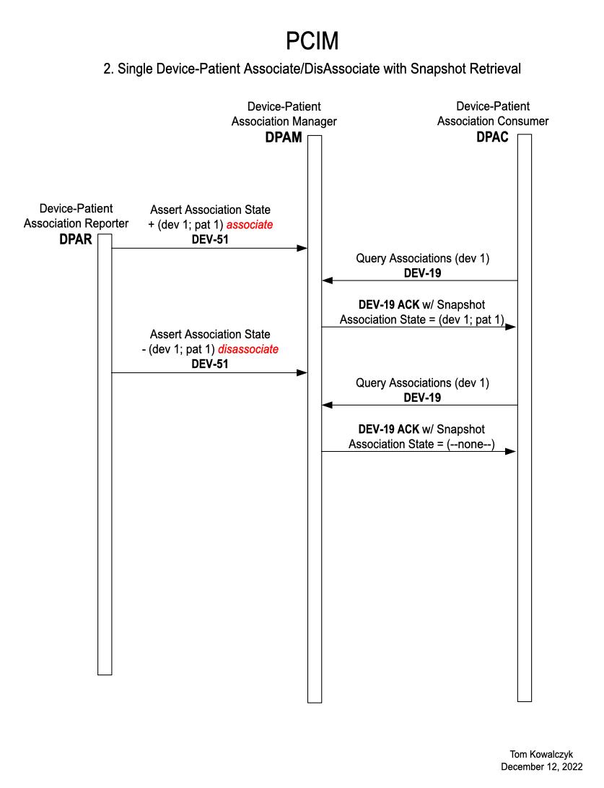
Associate/Disassociate Sequence Diagram

